Slide 1

DIABETES PREDICTION ANALYSIS
Project 4 Team Members:
Eva Brown
Jeff He
Magdalene Singh

Slide 2

Content
Introduction
Proposed Approach
Background
Overview of Machine Learning
Exploring the Data
Modelling the Data
Comparison
Page Launch

Slide 3
INTRODUCTION
Welcome to our Diabetes Prediction Analysis presentation.
Applications used:
Python Pandas
Python Matplotlib
Numpy
Scikit-learn
Streamlit

Slide 4
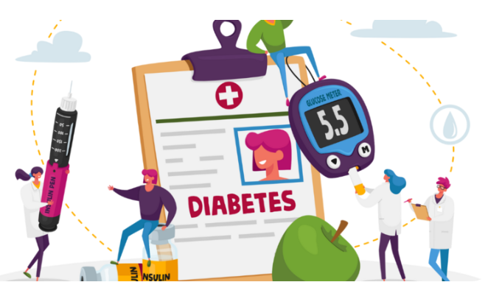
Proposed approach
Our project aim was to predict the probability of developing Diabetes by applying Machine Learning.
Logistic Regression & Random Forest were used to evaluate the accuracy of the prediction outcome.
The dataset of 100,000 entries was obtained from kaggle.com:
https://www.kaggle.com/datasets/iammustafatz/diabetes-prediction-dataset

Slide 5
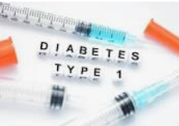
Background
Diabetes
Chronic medical condition
Elevated levels of blood glucose (or blood sugar).
The body either does not produce enough insulin or cannot use the insulin it produces.
Three main types of diabetes:
Type 1 Diabetes:
Immune system destroys insulin-producing beta cells in the pancreas.
Insulin injections or an insulin pump required to manage blood sugar levels.

Slide 6
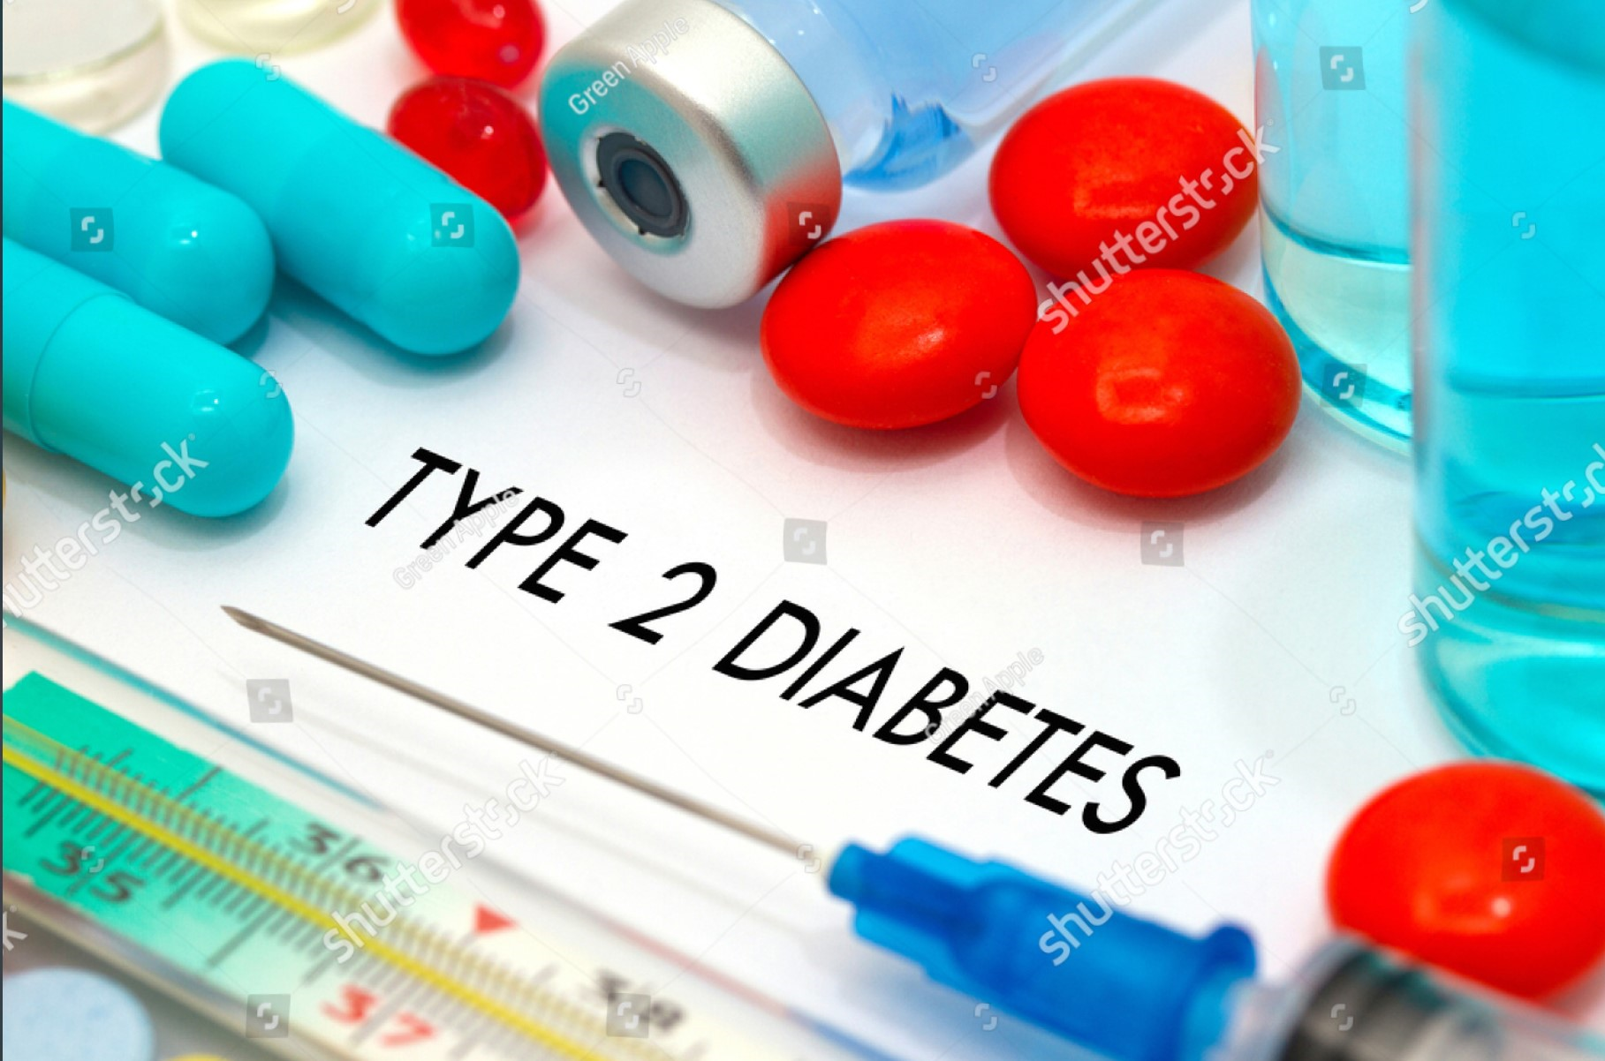
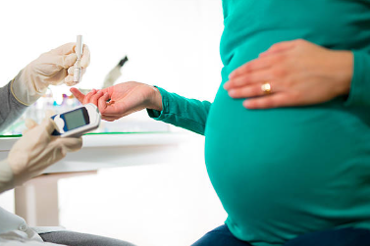
Background
Type 2 Diabetes:
Inability to use insulin properly (insulin resistance) or insufficient production of insulin.
Lifestyle factors: obesity, lack of physical activity & genetic predisposition.
Managed through lifestyle modifications, oral medications & insulin therapy.
Gestational Diabetes:
Occurs during pregnancy.
Resolves after childbirth.

Slide 7
Common symptoms of diabetes:
If left untreated, diabetes can lead to serious health consequences such as :
increased thirst | unexplained weight loss | fatigue
frequent urination | blurred vision
heart disease | kidney damage | vision problems
stroke | nerve damage

Slide 8
Management of diabetes:
Regular medical check-ups are essential for early detection of health consequences and effective diabetes management.
maintaining blood glucose levels within a target range through a combination of medication | lifestyle changes such as healthy eating, regular physical activity, stress management
regular glucose monitoring | regular medical check-ups

Slide 9
As of January 2022, it is estimated that approximately 10% of the world's adult population has diabetes.
The prevalence of diabetes has been increasing globally and varies by region.

Slide 10
Overview of machine Learning
Tune
Training Data
Model
Deploy
Predictor
Data Source
Result based on model trained
Testing Data
Evaluation of model
Gathering &
pre-processing data
Training & testing the data

Slide 11
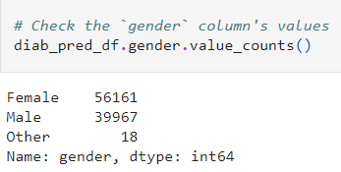
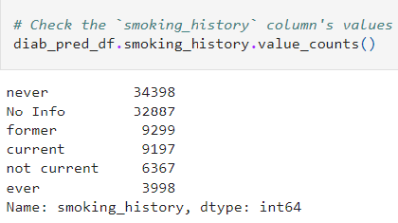
EXPLORing the Data
Read the diabetes_prediction_dataset.csv data into a Pandas DataFrame.
Fields:
Transformed the data.
renamed & regrouped the smoking_history & gender fields
gender | hypertension | heart_disease | HbA1c_level | diabetes
age | smoking_history | bmi | blood_glucose_level

Slide 12
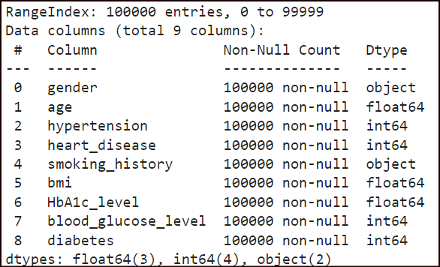
Exploring the Data
Checked for missing data
12

Slide 13
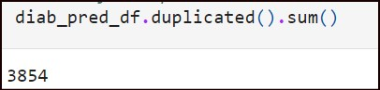
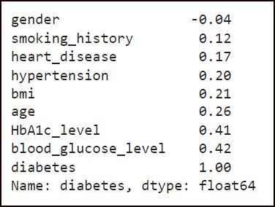
Exploring the Data
Dropped duplicated rows
Find the correlation between each feature and diabetes outcome.
13

Slide 14
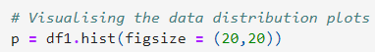
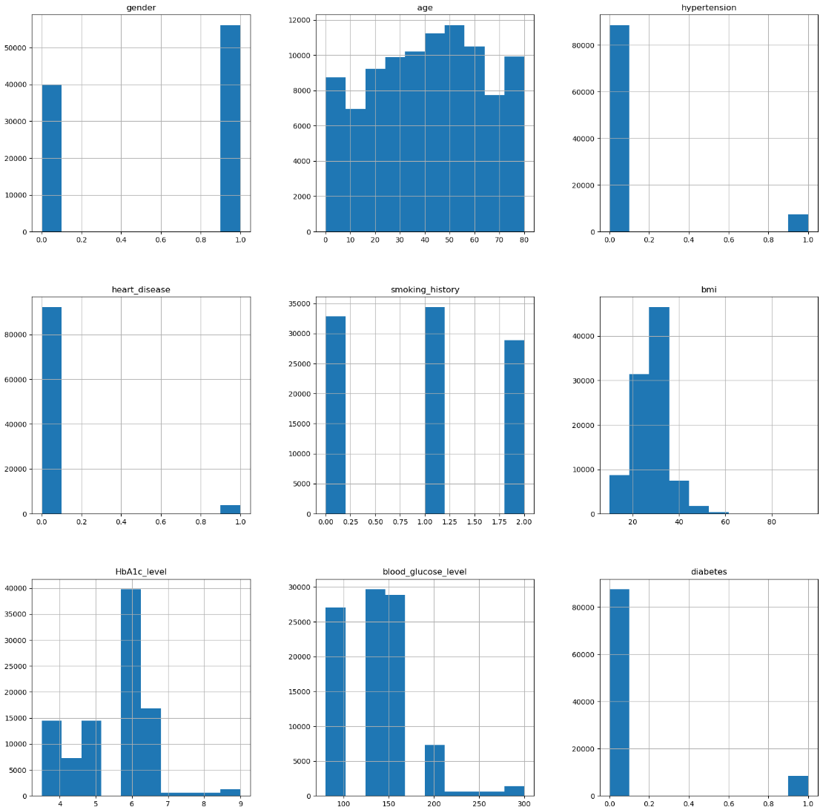

Slide 15
Modelling the Data
The dataset was split into training and testing datasets.
Evaluated the data.
Used Logistic Regression as the initial model.
According to studies, Random Forest was shown to be a more accurate model for health predictions.
We used the Random Forest model for our Diabetes Predictor web page.

Slide 16
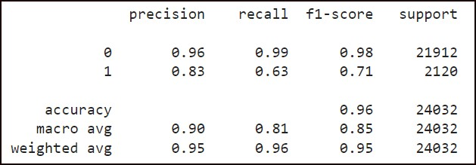
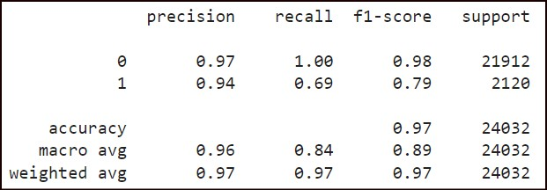
Compare Classification reports
Logistic Regression Random Forest
The Random Forest model has a higher precision (94% vs. 83%), indicating fewer false positives.
The Random Forest model has a higher recall (69% vs. 63%), meaning it captures more true positives among all actual positives.
The f1-score for class 1 is notably higher for the Random Forest model (79% vs. 71%).

Slide 17
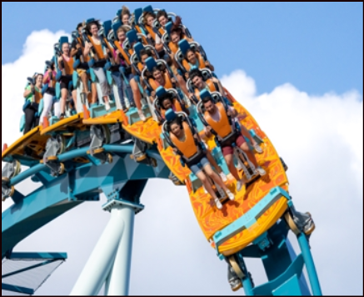
Hold on to your seats while we …

Slide 18

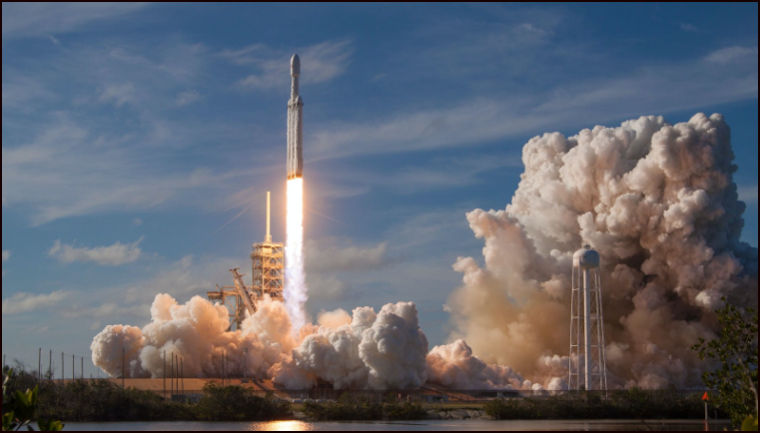
LAUNCH our page

Slide 19
The page can be launched directly from GitHub:
https://github.com/EvaB5050/Diabetes-Prediction-Analysis.git

Slide 20

Thank you for watching our presentation

Slide 21
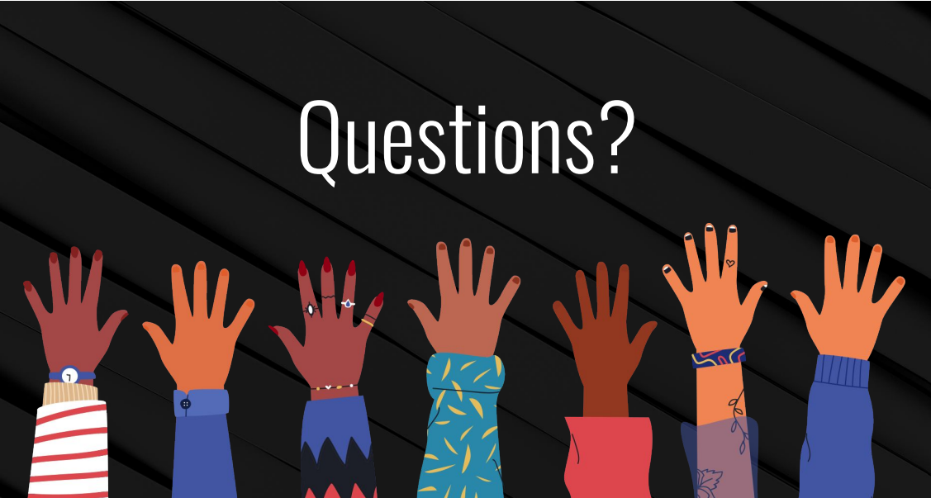

Slide 22


And that, my dear fellow students, marks the end of our Data Analytics BootCamp.
Let’s embrace life once again ☺

